Slide 1
Hotel Booking
WONG WING YIN
Li Yueting
Cheung Ho Cheung
Tang Wing Ying
Chow Wang Hin
Ho Cheuk Tung

Slide 2
Table of contents
01
02
03
04
05
Predictive models
Evaluate and Compare models
Purpose
Linear Regression
Decision Tree
Logistic Regression
SVM
KNN
Conclusion
Q&A

Slide 3
Purpose
To predict whether a hotel booking will be cancelled or not
Having predictive models, hotels can make more informed decisions and implement proactive strategies, such as targeted marketing to reduce cancellations

Slide 4
01
Linear Regression

Slide 5
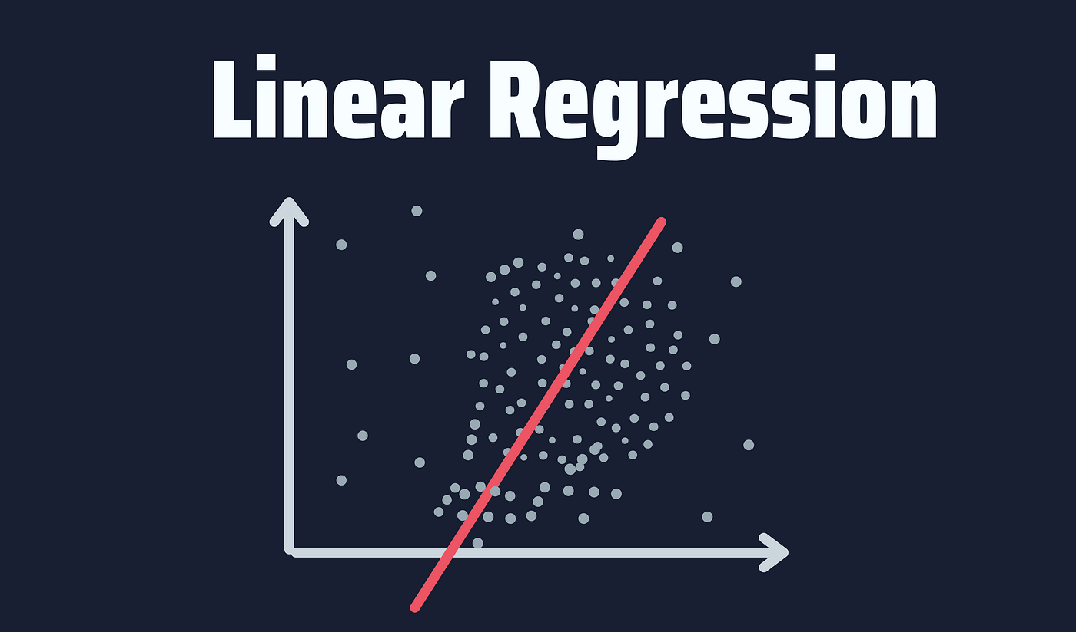
What is linear regression
used to predict the value of a variable (dependent variable) based on the value of another variable (independent variable)
use to predict continuous variable

Slide 6


Applying linear regression to hotel booking
Target variable: “is_canceled”
0: not cancel, 1: cancel
processing steps:
fill in the null values
drop the data with 0 children, adults, babies
find categorical data, encoding categorical variables
normalizing numerical variables
linear regression > predict continuous variable
round up predict result to 0,1,2 (not cancel, cancel, out of range)

Slide 7
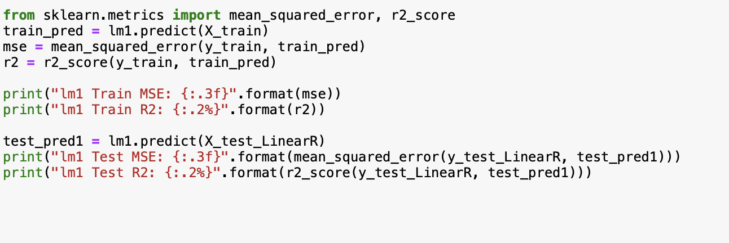
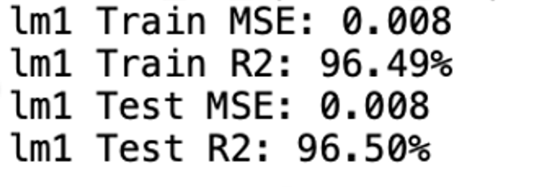
MSE & R2
Both MSE is 0.08 & R2 > 96%
Good prediction

Slide 8
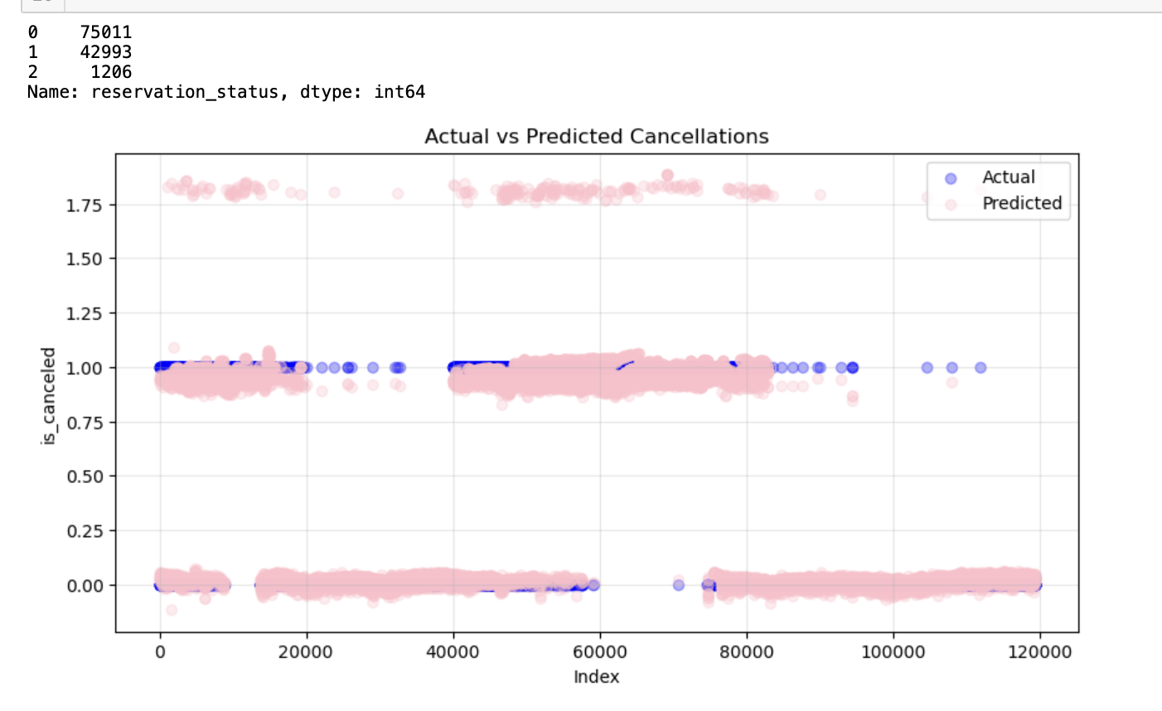
Relationship between Actual vs Predicted Cancellations
blue scatter > actual cancellations (not cancel: 0, Canceled: 1, out of range: 2)
pink scatter > predicted cancellations
predicted cancellations > match well
Overall > predicted values capture the actual cancellation trends relatively well
some deviations
However, since we have rounded up our results before, this prediction may be misleading.

Slide 9
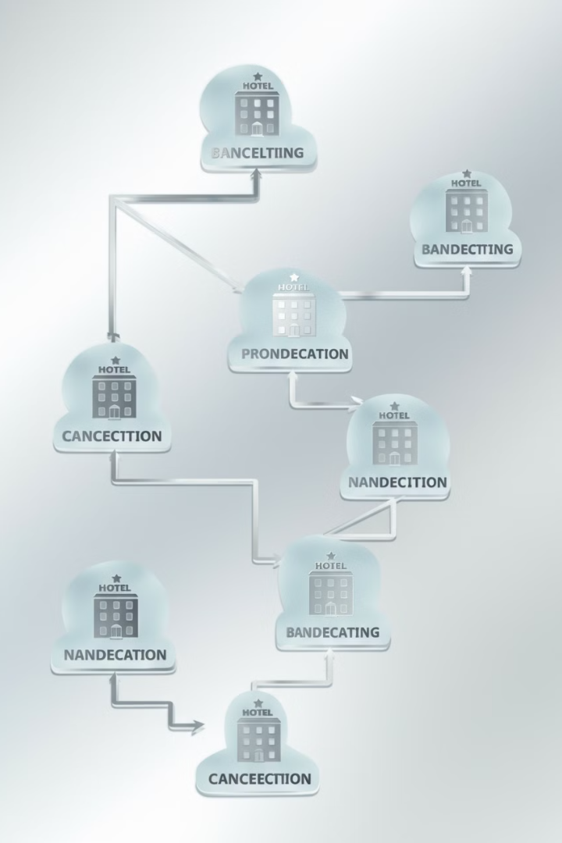
02
Decision Tree

Slide 10

What is a Decision Tree?
Definition
Components
A Decision Tree is a supervised learning algorithm used for classification and regression tasks.
Nodes: Represent features
(e.g., lead time, hotel type).
Edges: Represent decision rules based on these features.
Leaves: Indicate the final predictions (e.g., booking canceled or not).
Use Cases
Effective for tasks like predicting whether a hotel booking will be canceled.
Target Variable: Predicting booking cancellations
(0 = Not Canceled, 1 = Canceled).

Slide 11
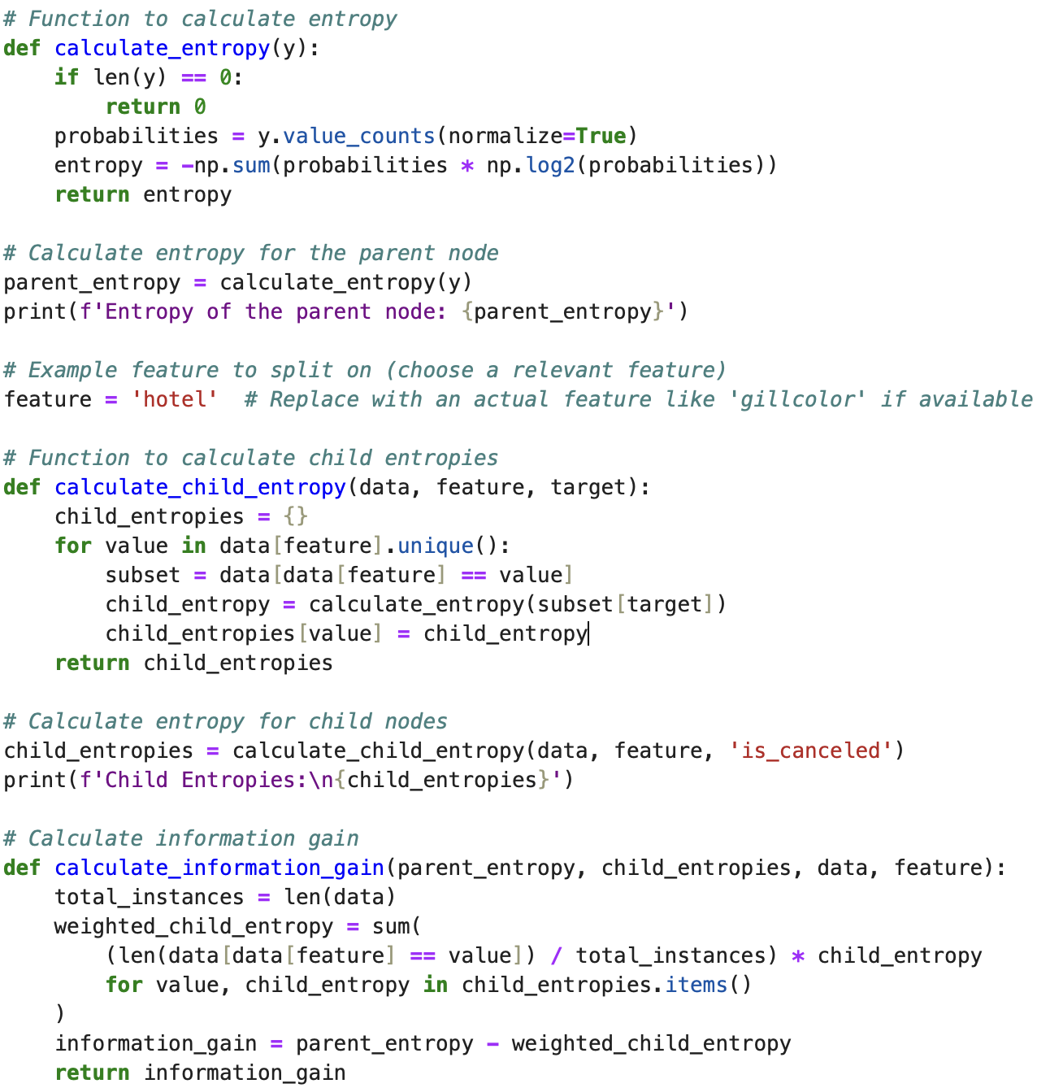
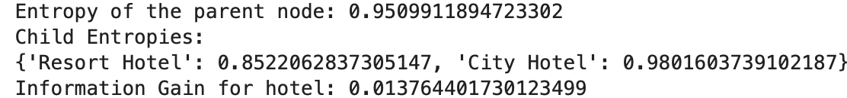

Steps:
Calculate Entropy
(Parent node entropy, child entropies)
2. Calculate Information Gain
3. Split Data into Train and Test
4. Model Training
5. Visualization
6. Evaluation

Slide 12
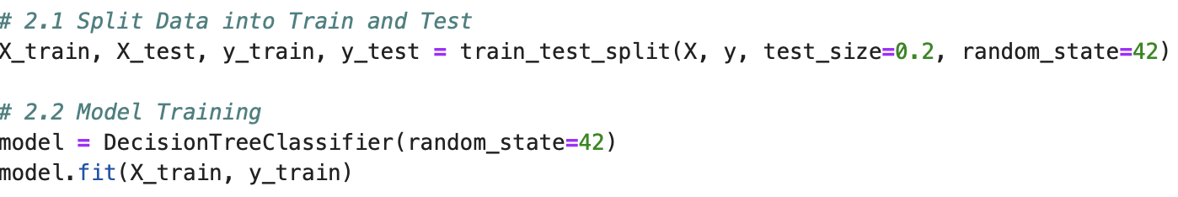
Steps:
Calculate Entropy
(Parent node entropy, child entropies)
2. Calculate Information Gain
3. Split Data into Train and Test
4. Model Training
5. Visualization
6. Evaluation

Slide 13
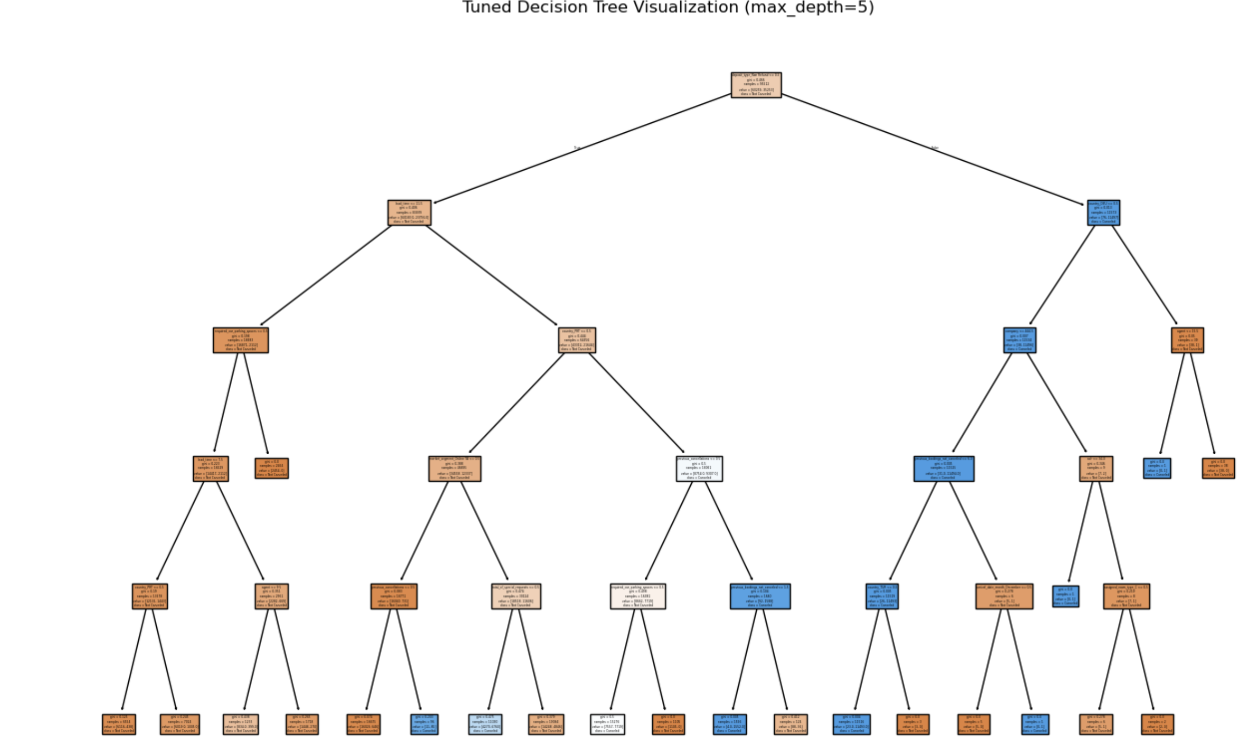
Steps:
Calculate Entropy
(Parent node entropy, child entropies)
2. Calculate Information Gain
3. Split Data into Train and Test
4. Model Training
5. Visualization
6. Evaluation

Slide 14
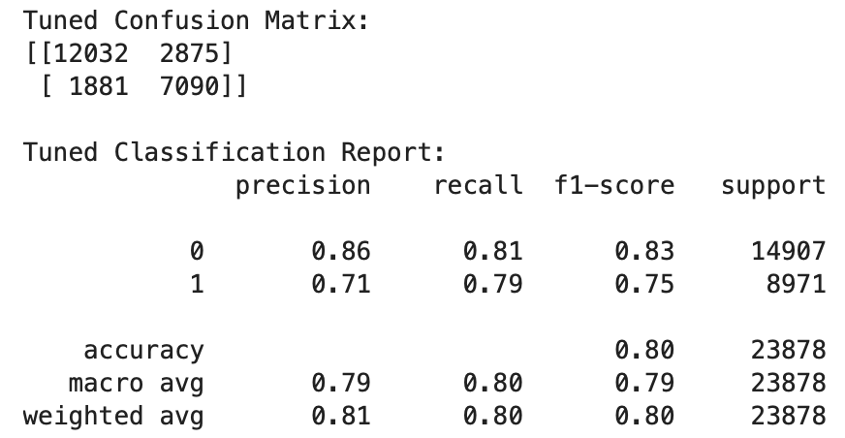
Steps:
Calculate Entropy
(Parent node entropy, child entropies)
2. Calculate Information Gain
3. Split Data into Train and Test
4. Model Training
5. Visualization
6. Evaluation

Slide 15
03
Logistic Regression

Slide 16
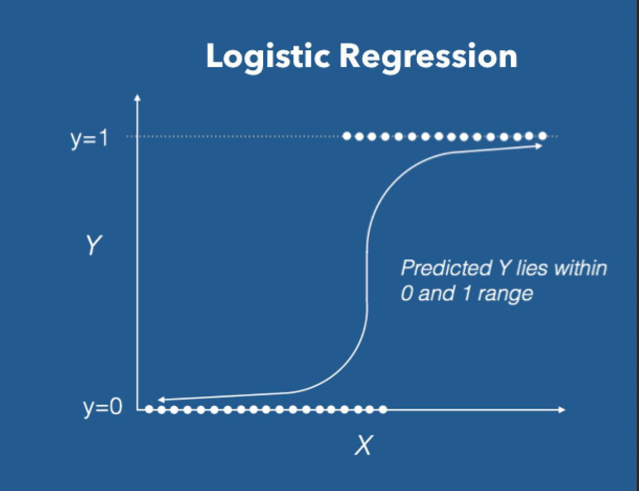
What is Logistic Regression?
A fundamental statistical and machine learning algorithm used for binary classification problems
Predict binary outcomes
Apply in case: cancel or not cancel

Slide 17
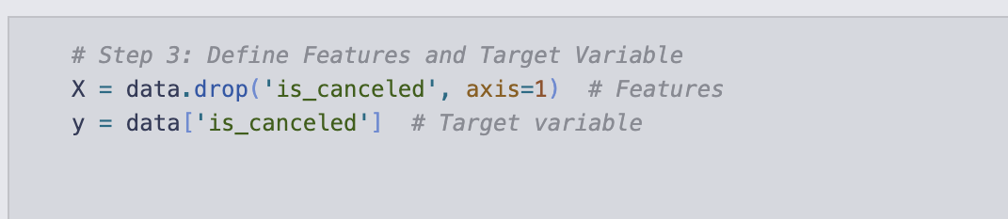
Convert Non-Numeric Features to
Numeric(fit_transform)
2. drop NaNcolumns:"country","agent","company"
3. Define Features and Target Variable: "is_canceled"
4. Split into Trian and Test
5. Scale Data

Slide 18
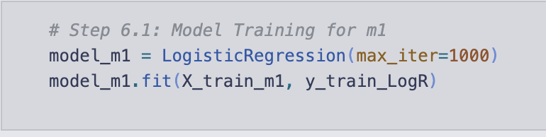
6. Train Model m1with Only two features:
"lead_time","adr"
6.1 Model Training for m1

Slide 19
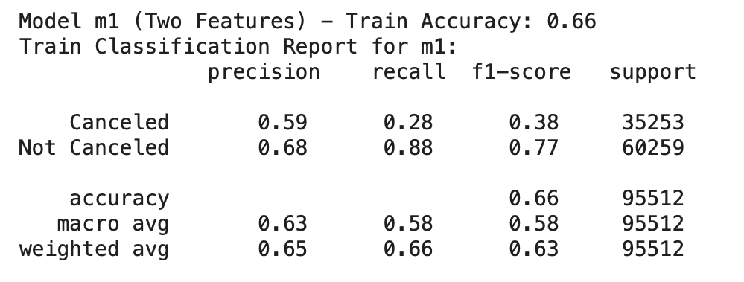
6.2 Predict and Evaluate on Train Set for m1
6.3 Log-Odds and Positive Probabilities for m1

Slide 20
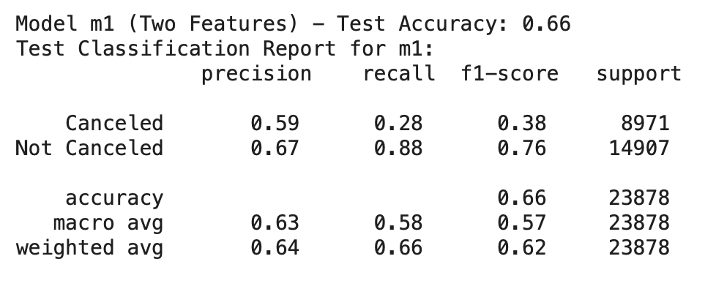
6.4 Predict and Evaluate on Test Set for m1

Slide 21
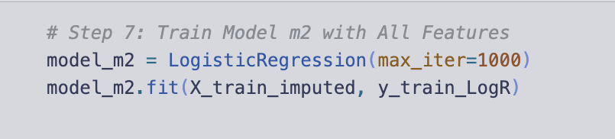
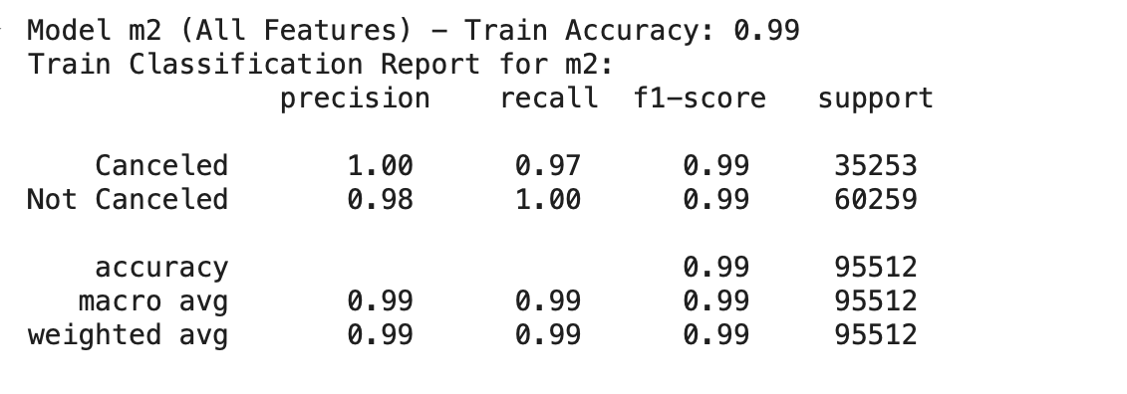
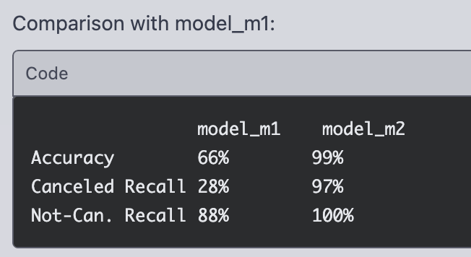
7. Train Model m2 with All Features
7.1 Predict and Evaluate on Train Set for m2

Slide 22
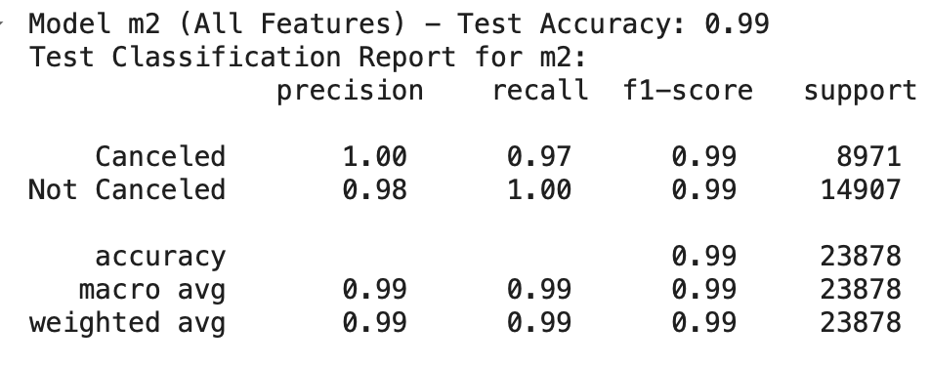
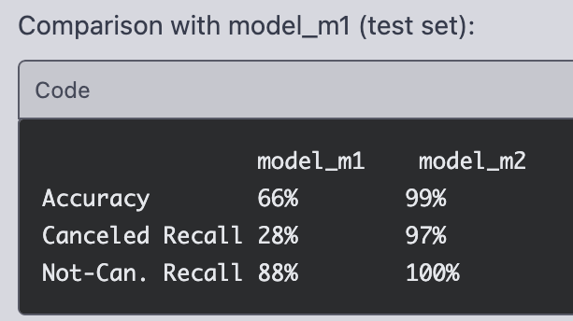
7.2 Predict and Evaluate on Test Set for m2

Slide 23
Support vector machine

Slide 24
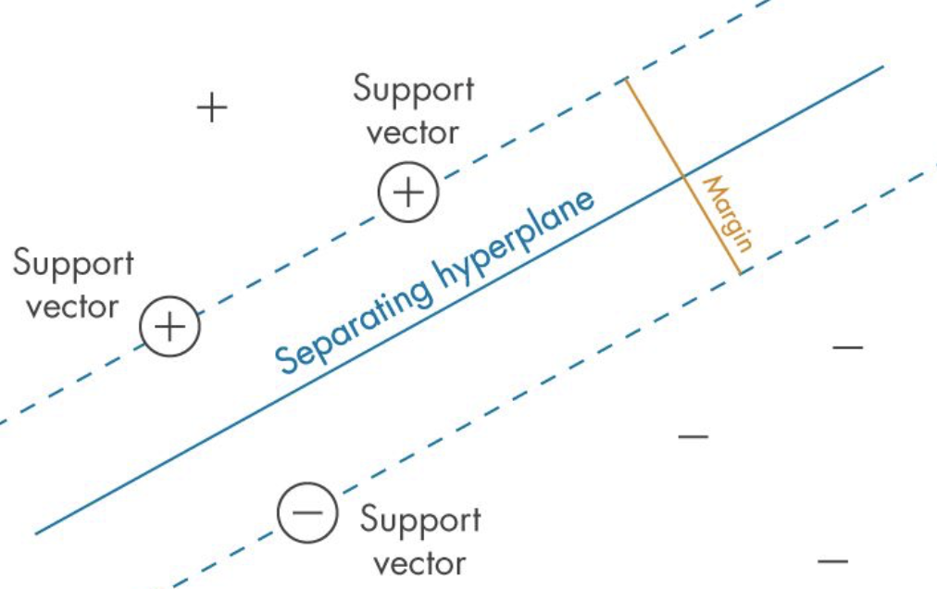
What is Support vector machine?
Powerful classification algorithms
uses an N-dimensional space to identify the best line or hyperplane
Improve accuracy
KEY
1.Linear Separability
2.Continuous variables

Slide 25
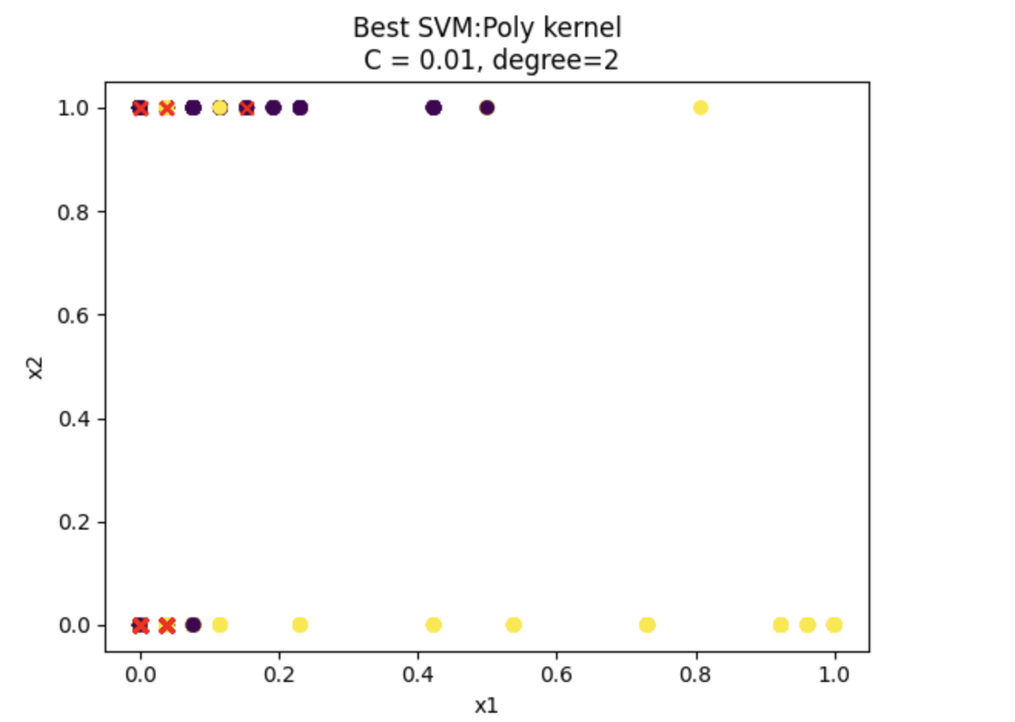
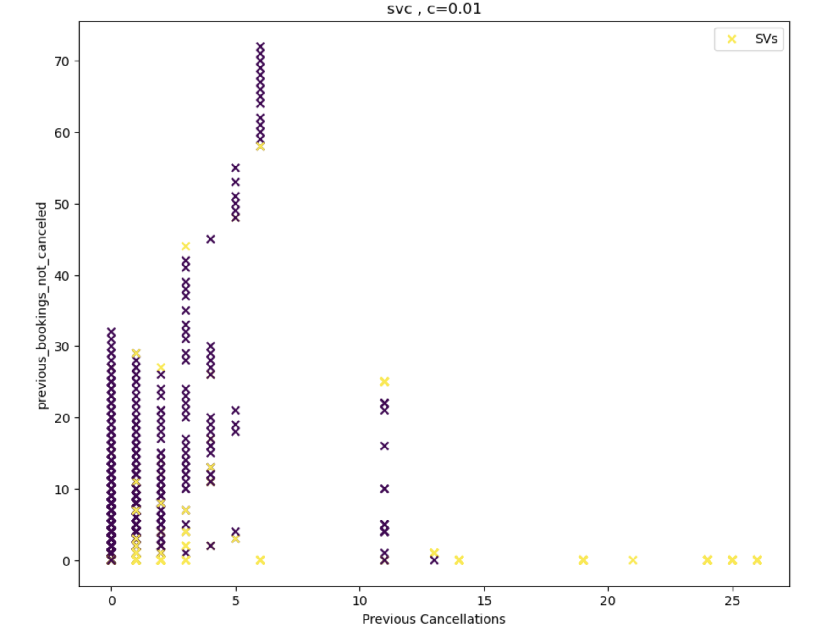
o
x1 =previous_cancellations
x2 = is_repeated_guest
y = is_canceled
C=0.01
x1 =previous_cancellations
x2 = pervious_booking_not_canceled
y = is_canceled
C=0.01

Slide 26
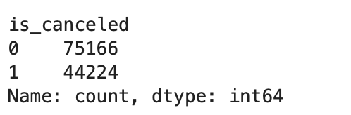
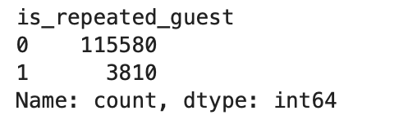
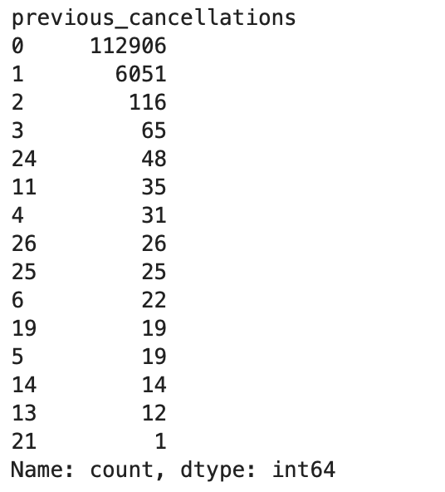
Problems
1.Class Imbalance
Unequal representation of classes
2.Feature Distribution
Diverse distribution of classes in feature space affects boundary clarity.
Overlapping classes can complicate the identification of a decision boundary.
3.Noise and Outliers
Presence of noise can obscure patterns, leading to misclassification.
Outliers can disproportionately influence the decision boundary.

Slide 27
KNN model

Slide 28
What is a KNN model ?
Definition
How it work
k-nearest neighbors algorithm (k-NN) is a non-parametric supervised learning method. it is used for classification, as a k-NN classifier
Object will be assigned to the class most common among its k nearest neighbors (k is a positive integer, typically small).
Key
Bigger k values: more neighbors used in prediction, simpler model (decision boundary).
Smaller k values: less neigbors used, more complicated model which tends to overfit.

Slide 29

Applying KNN model to Hotel Bookings
Target Variable
Preprocessing Steps
Predicting booking cancellations
(0 = Not Canceled, 1 = Canceled).
Handling missing values.
encoding categorical variables
normalizing numerical variables
Use GridSearchCV to find the best k and the mean cv score
Visualize mean cv scores for each k value

Slide 30
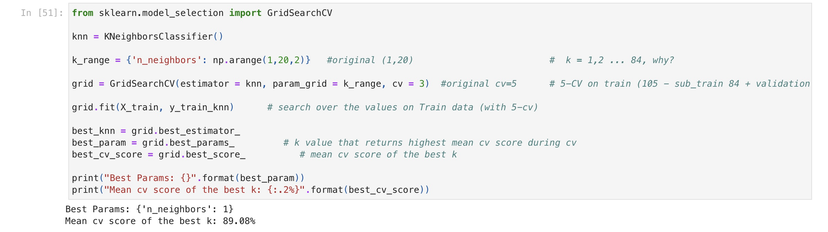

Slide 31
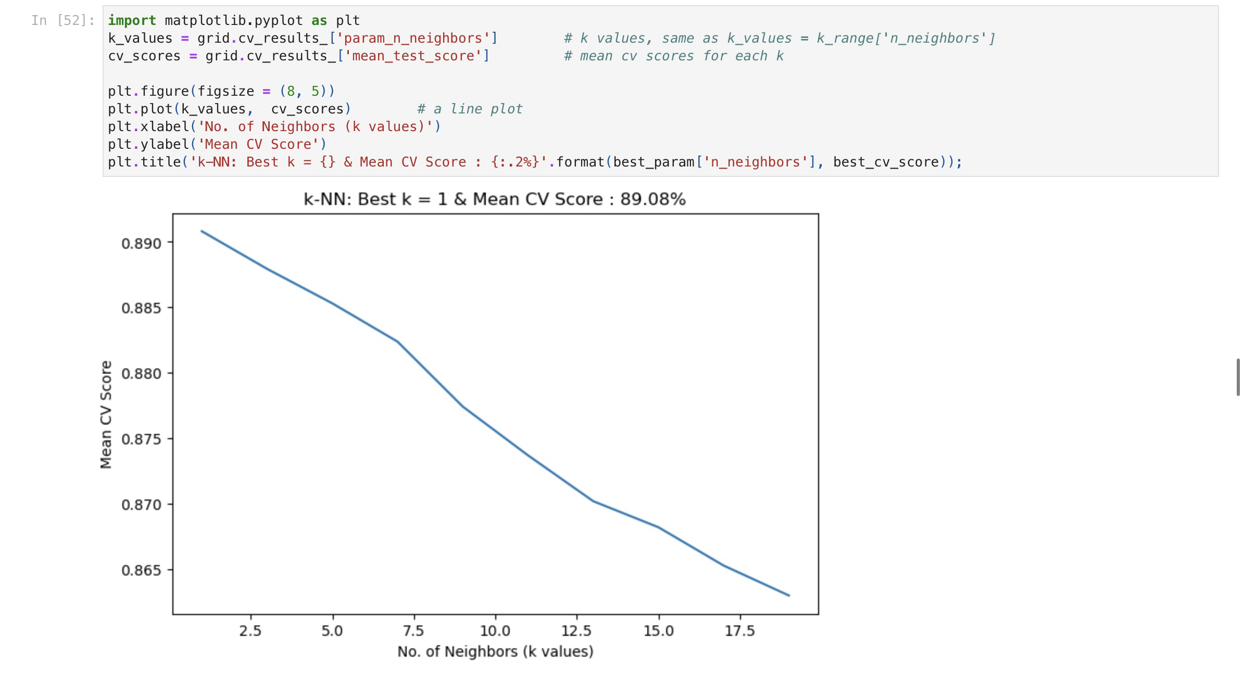
Problem
1-NN model overfits very strongly
It often leads to worse performance on unseen data

Slide 32
Evaluate and Compare models

Slide 33
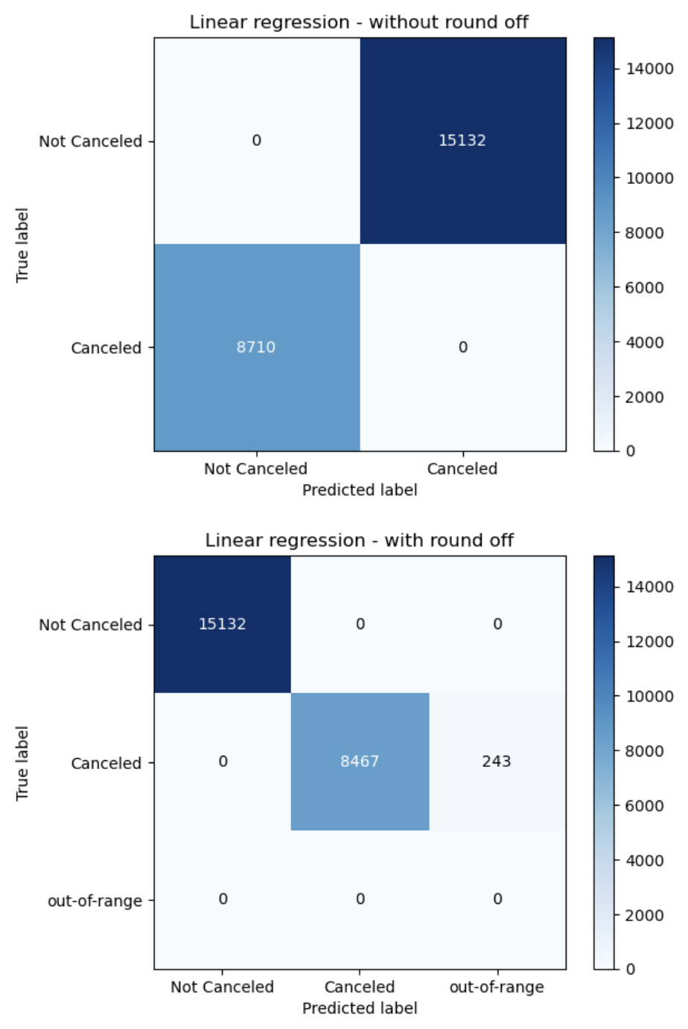
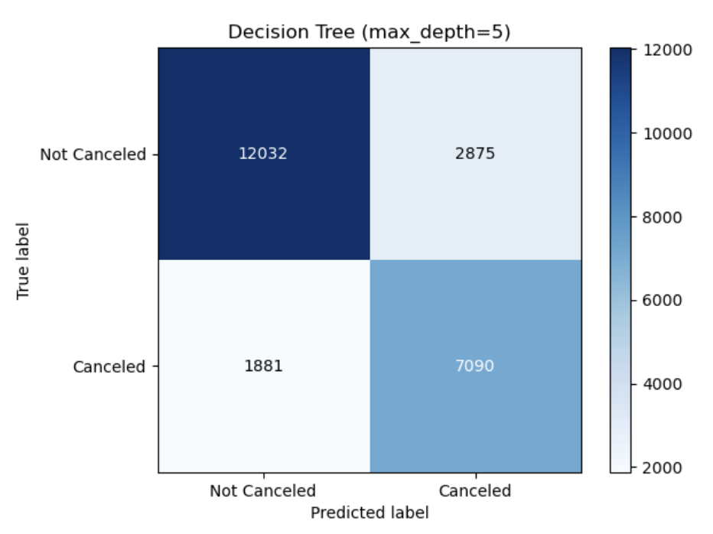
Confusion Matrix
Linear Regression
Decision Tree
Since linear regression is for predicting continuous variable, but cancel/not cancel is binary variable.
Thus, some predicted value is out-of-range.

Slide 34
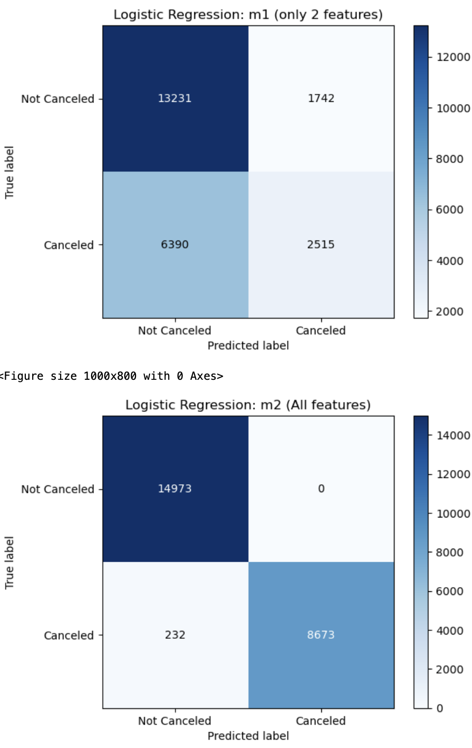
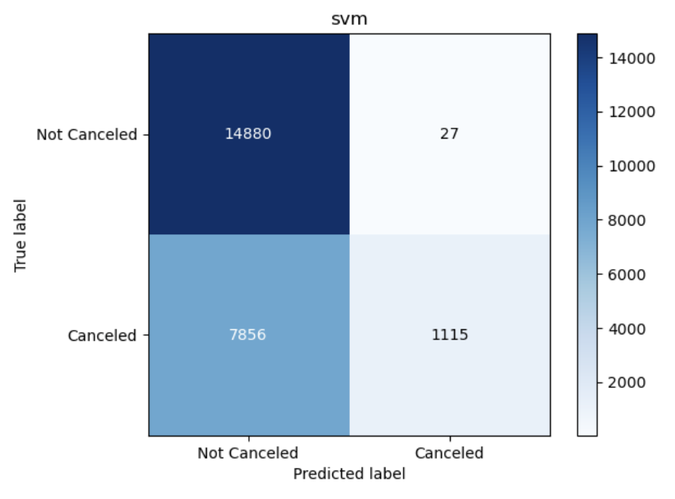
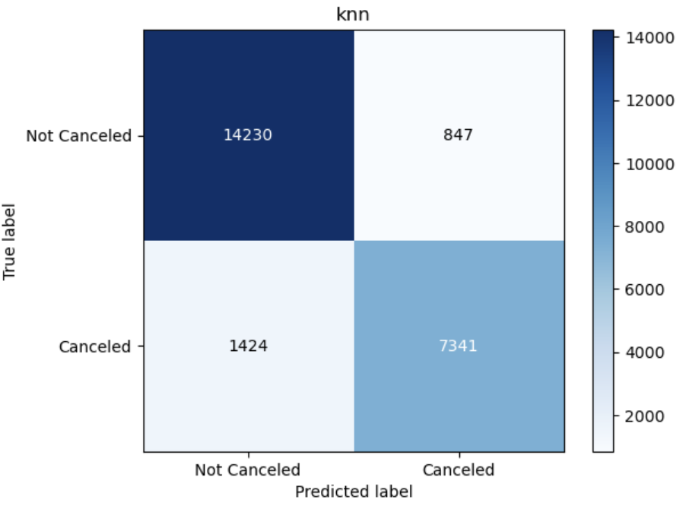
SVM
Linear Regression
knn

Slide 35
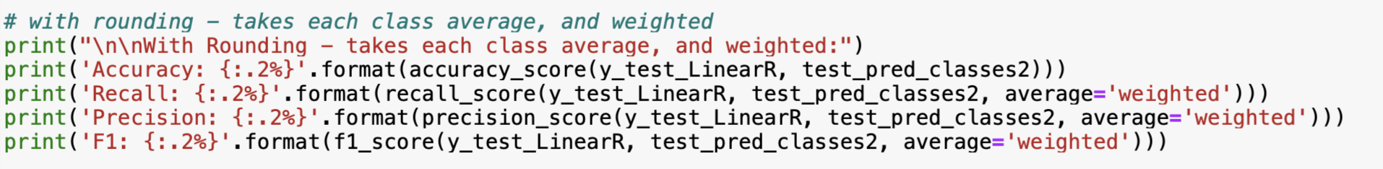
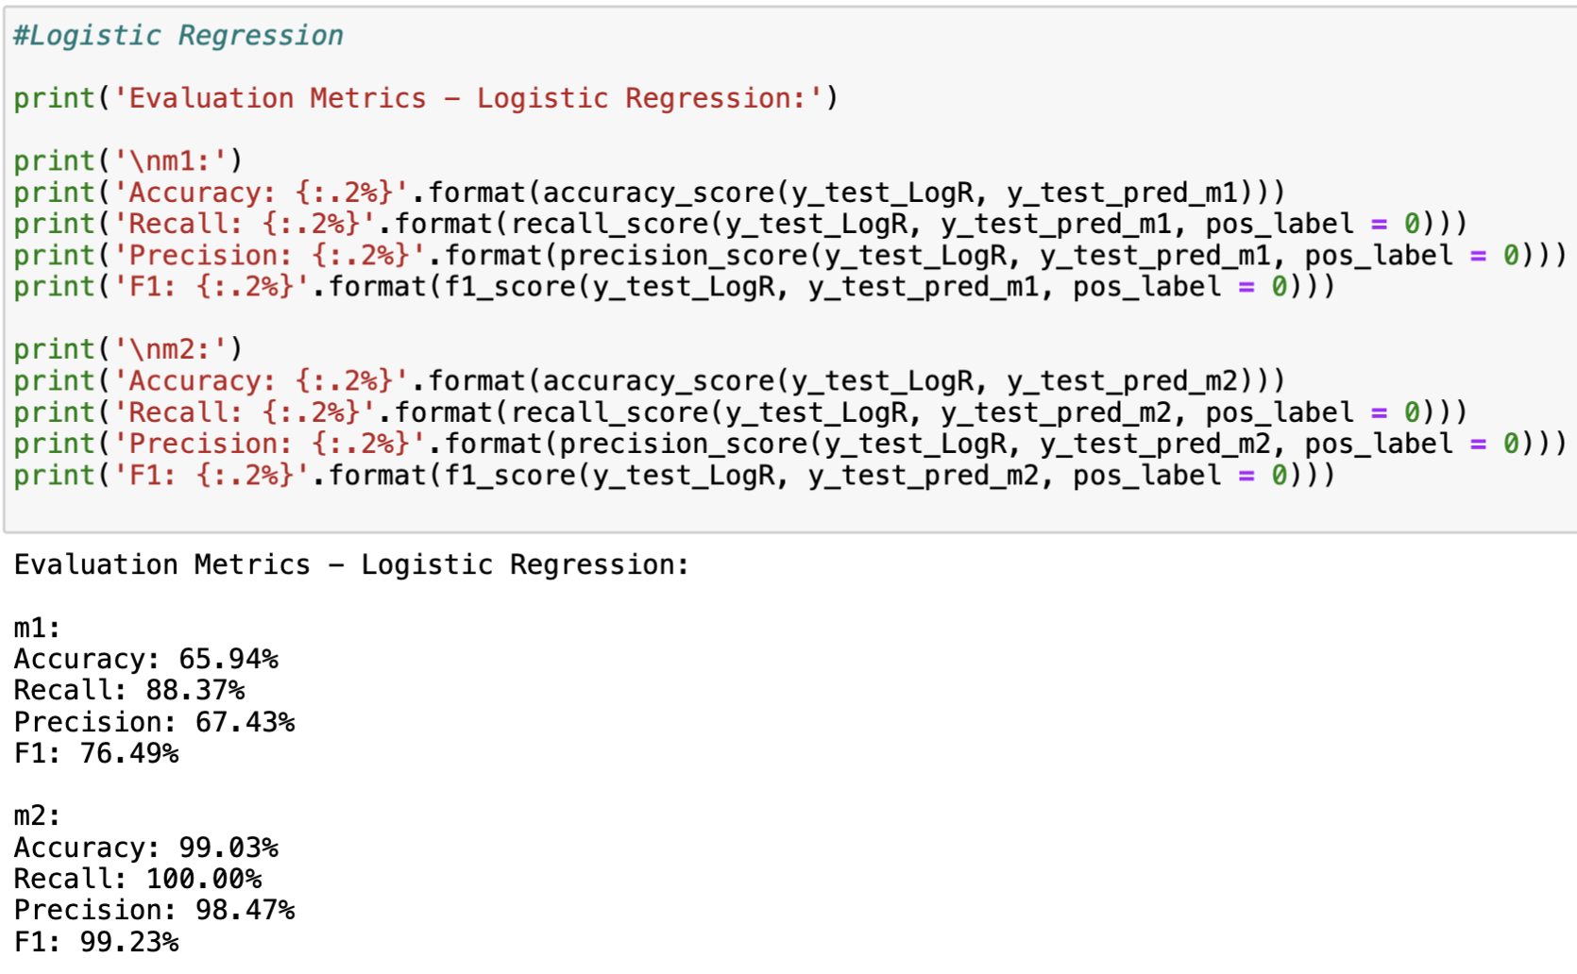
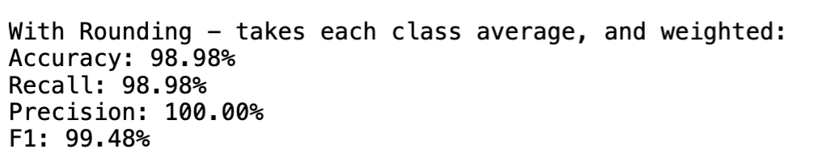
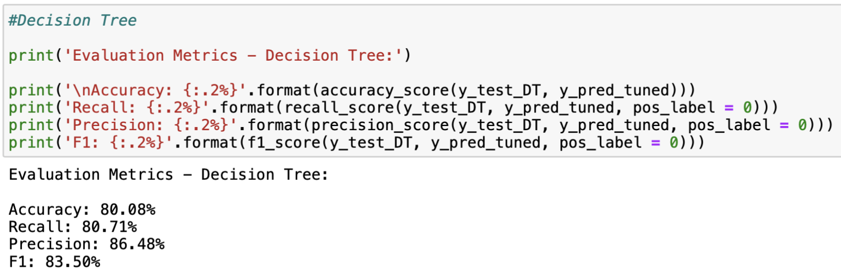
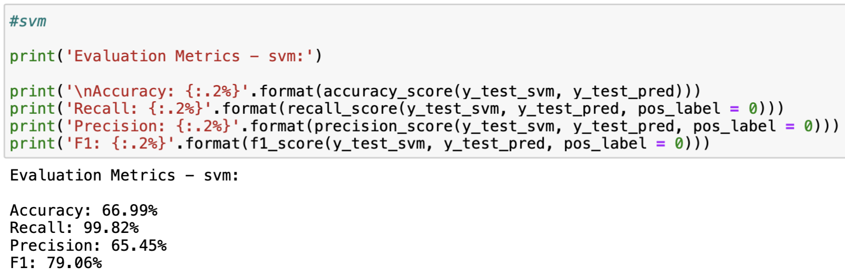
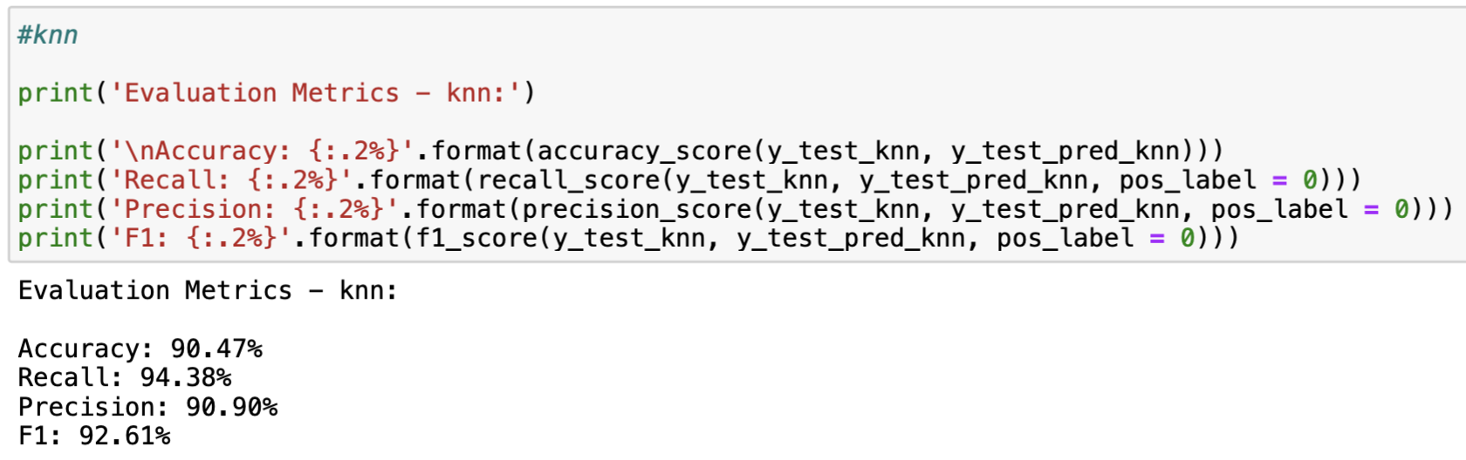
Evaluation Metrics

Slide 36
Evaluation Metrics
Linear Regression
Decision Tree
SVM
Accuracy: 98.98%
Recall: 98.98%
Precision: 100.00%
F1: 99.48%
Accuracy: 80.08%
Recall: 80.71%
Precision: 86.48%
F1: 83.50%
Accuracy: 66.99%
Recall: 99.82%
Precision: 65.45%
F1: 79.06%

Slide 37
Evaluation Metrics
Logistic Regression (M1)
Logistic Regression (M2)
knn
Accuracy: 65.94%
Recall: 88.37%
Precision: 67.43%
F1: 76.49%
Accuracy: 99.03%
Recall: 100.00%
Precision: 98.47%
F1: 99.23%
Accuracy: 90.47%
Recall: 94.38%
Precision: 90.90%
F1: 92.61%

Slide 38
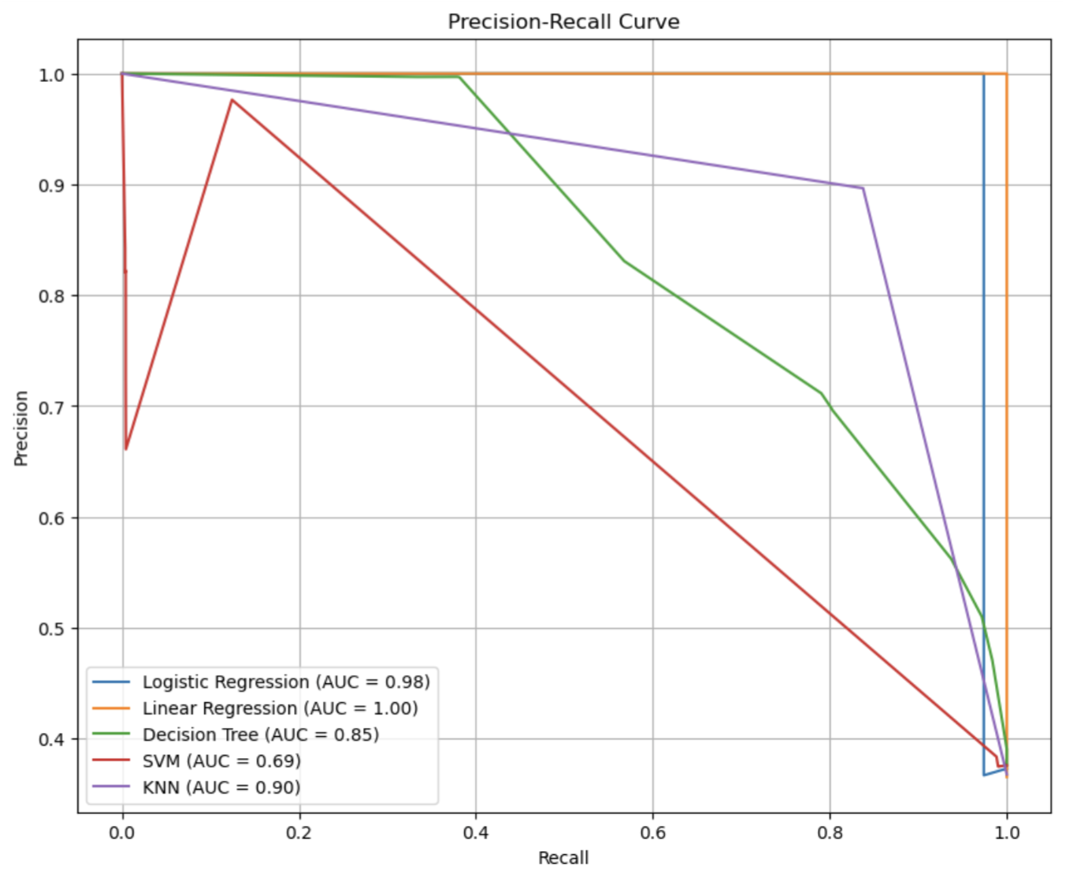
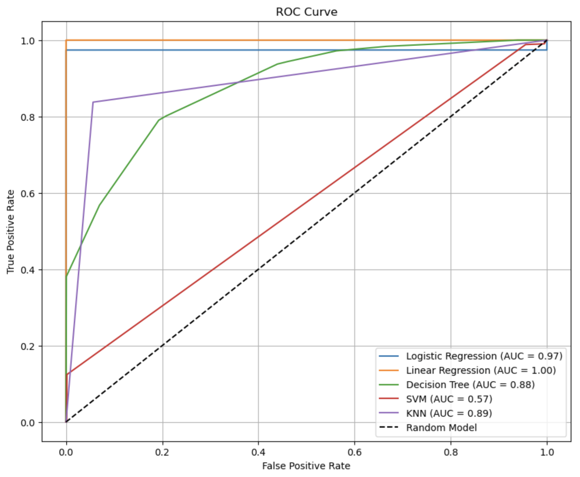
Precision-Recall Curve & ROC Curve
AUC value
Logistic Regression: 97.39%
Linear Regression (M2): 100.00%
Decision Tree: 88.02%
SVM: 57.46%
KNN: 89.07%

Slide 39
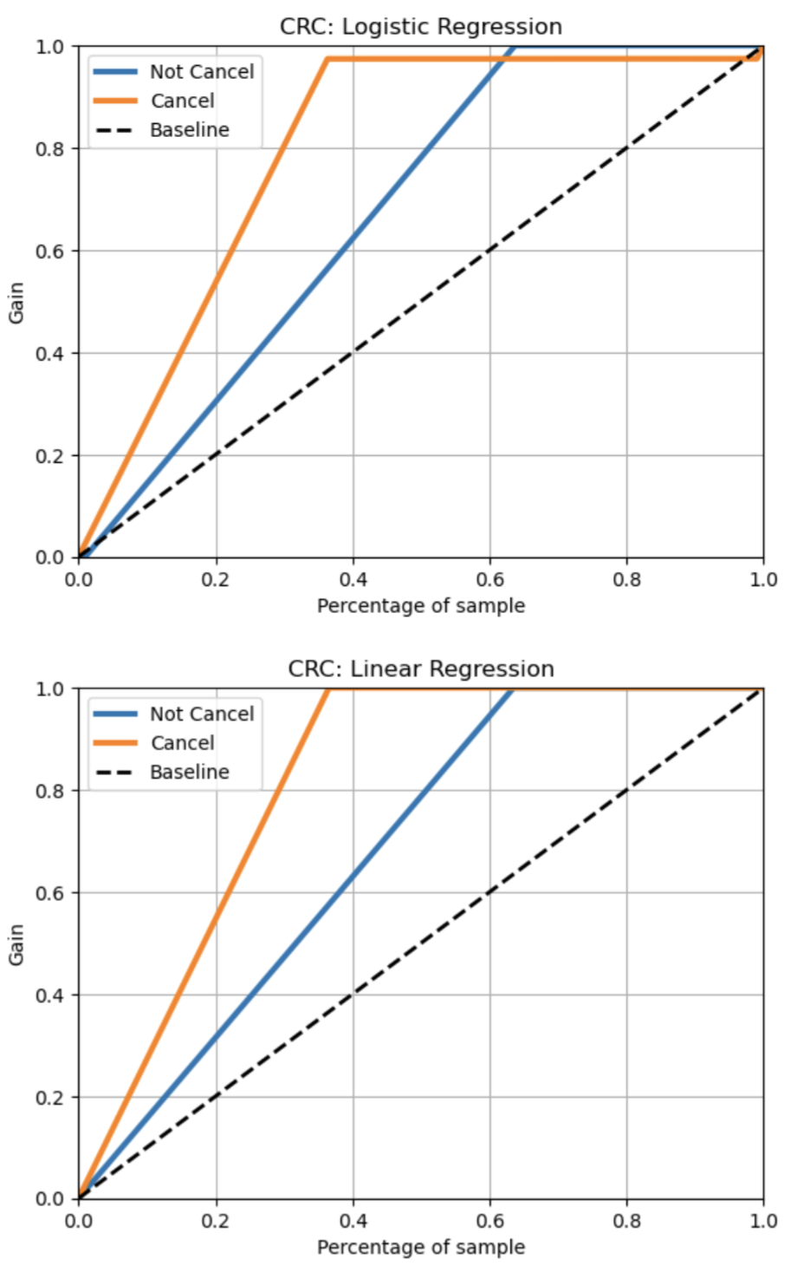
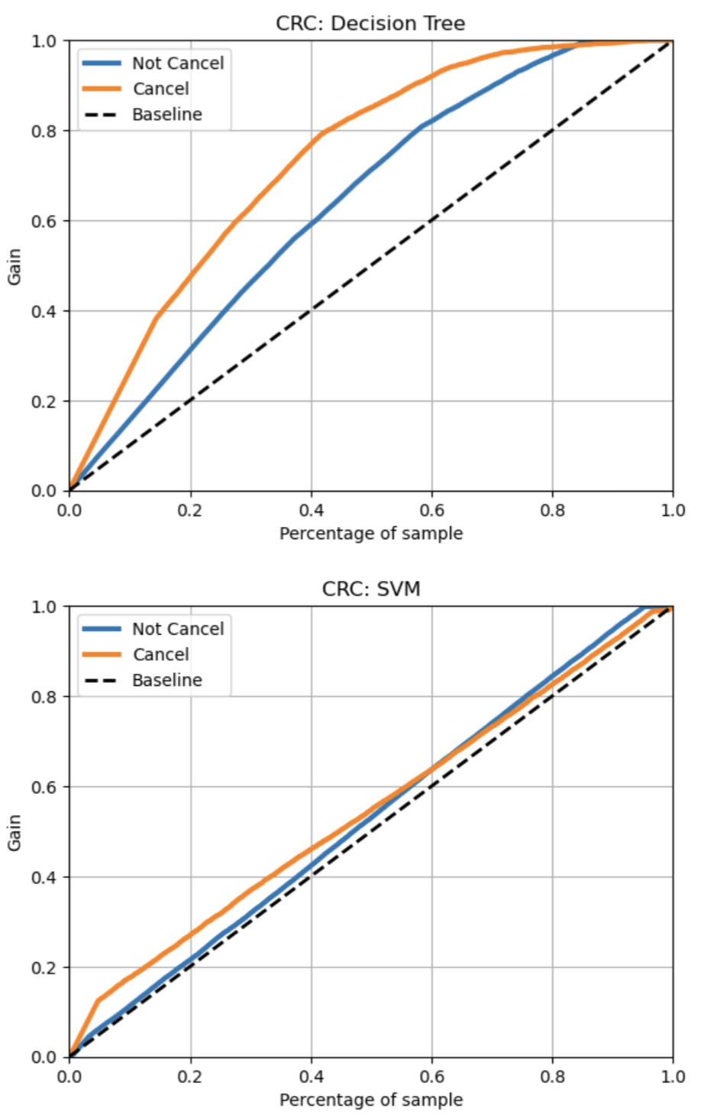
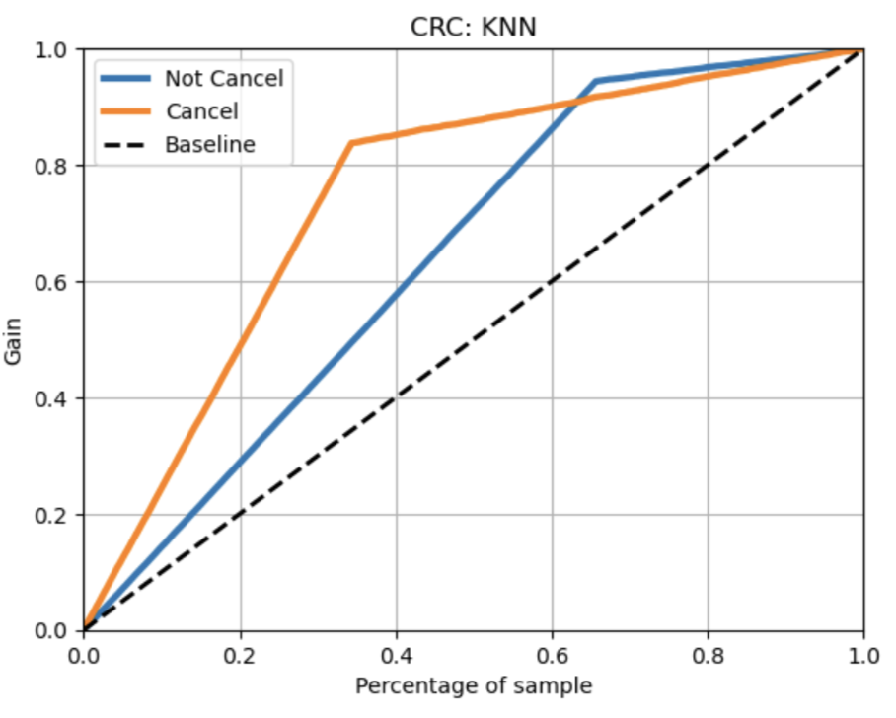
Cumulative Response Curve (CRC)
Good performance:
Logistic Regression
Linear Regression

Slide 40
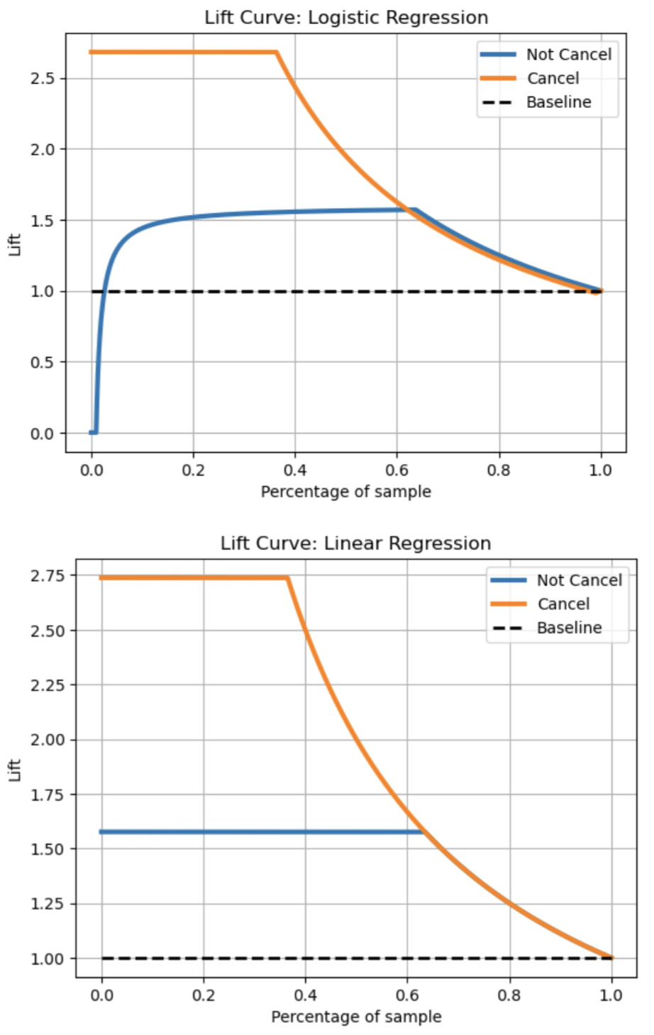
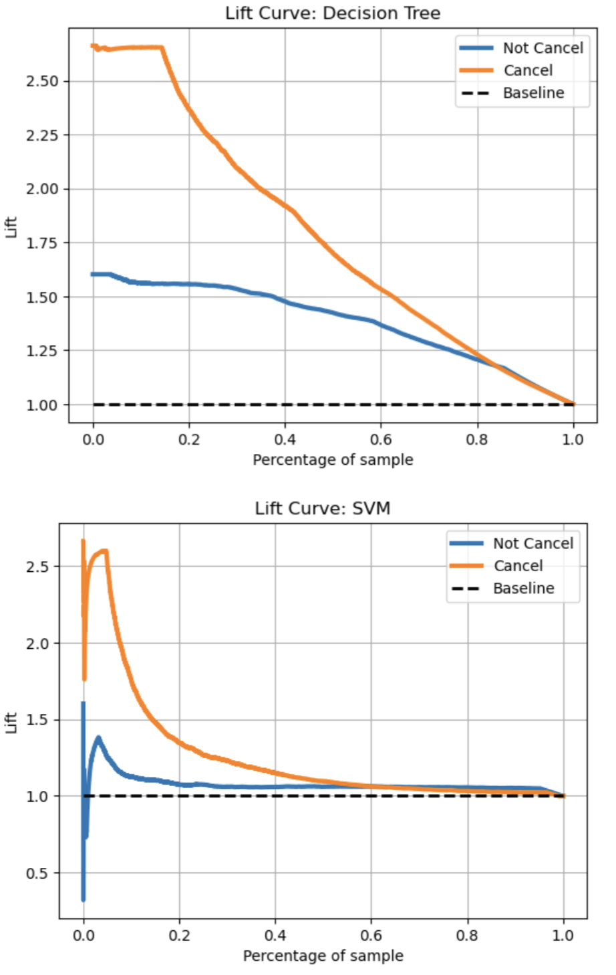
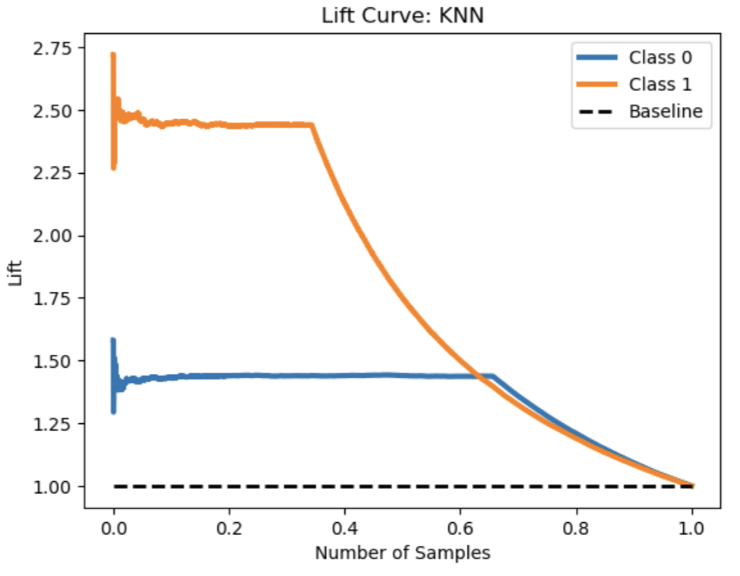
Lift Curve
Good performance:
Logistic Regression
Linear Regression

Slide 41
Conclusion: Best Model
Logistic Regression
Linear Regression
Good performance in evaluation metrics
Good performance in evaluation metrics
Good performance in ROC, CRC, Lift Curve
Good performance in ROC, CRC, Lift Curve
ideal for binary classification
struggles with
binary classification
(since it is designed for continuous outputs)
Best Model

Slide 42
Thanks!

